Slide 1
ETL

Slide 2
WHY ETL?
Companies need a way to analyze their data for critical business decisions.
Transactional Database can’t answer complex business questions.
A data warehouse provide a common data repository.
ETL provide a method of moving the data from various source into a data warehouse.

Slide 3
ETL CONCEPT
A Company data may be scattered in different locations and in different formats.
ETL Allows you to:
Migrate the data into a data warehouse.
Convert the various formats and types to adhere to one consistent system.
ETL is a predefined process for access and manipulate source data and loading it into a target database.

Slide 4
ETL REQUIREMENTS
Any ETL Architecture must meet the following requirements:
Business Requirement
Compliance Requirement
Data Profiling
Data Security
Data Integration
Right Data at Right Time
Final End User Delivery Interface
Available Skills
Alignment with overall Enterprise Architecture

Slide 5
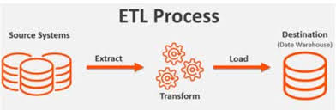
THE ETL PROCESS

Slide 6
EXTRACT
Gathering the data
Raw data that was written directly into the disk
Data written to flat files or relational tables from structured source systems
Data can be read multiple times, if needed.
Cleansing the data
Eliminateduplicates or fragmented data
Exclude unwanted / unneeded information

Slide 7
TRANSFORM
Preparing the data to be housed in the data warehouse.
Converting the extracted data
Using rules and lookup tables
Combining data
Verification/Validity checks
Standardization

Slide 8
LOAD
Storing the transformed data in the data warehouse.
Batch/Real-time processing
Can follow star schema and snowflake schema

Slide 9
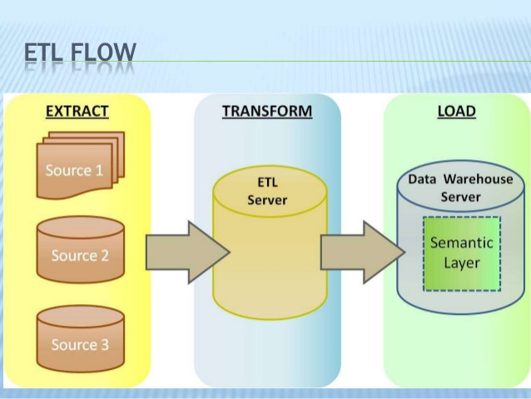
ETL FLOW

Slide 10
ADVANTAGE OF ETL TOOL
Simple, faster and cheaper development
Most ETL tools provide a metadata repository, synchronizing metadata from various sources.
Most ETL tools deliver good performance, even for very large dataset.
Most ETL tools provide impact analysis tools for any proposed schema changes.
Most ETL tools have built-in connectors for all the major RDBMS systems

Slide 11
ADVANTAGE OF ETL TOOL
Most ETL tools allow reuse of the existing complex programs.
Several ETL tools offers visual Development Environment.
Most ETL tools offers built-in scheduler sequencers and documentation.
Several ETL tools offer various performance optimization options such as (parallel processing, complex load balancing etc)

Slide 12
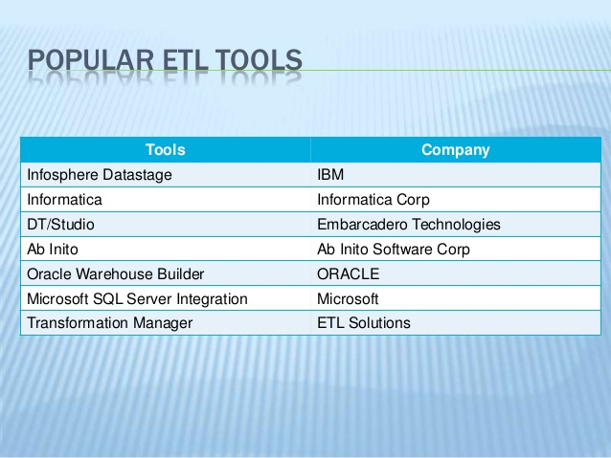
POPULAR ETL TOOLS

Slide 13
Data Warehouse
A physical repository where relational data (current and historical) are specially organized to provide enterprise-wide, cleansed data in a standardized format

Slide 14
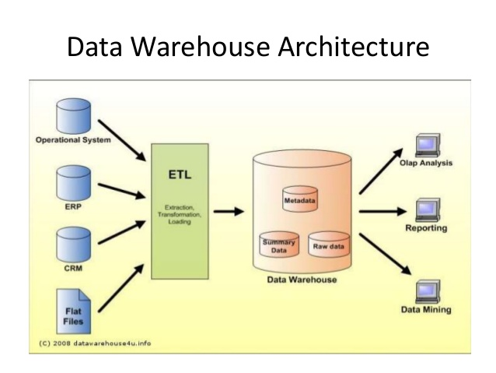
Data Warehouse

